Slide 1
Pendulum
Presented by: Thomas Wong

Slide 2
What is Pendulum?
A python library that makes DateTime easy
Extra features for developers as well
Not the only library that does this
Notes:
The Pendulum class is a replacement for the native datetime one with some useful and intuitive methods, the Interval class is intended to be a better time delta class and, finally, the Period class is a datetime-aware timedelta.

Slide 3
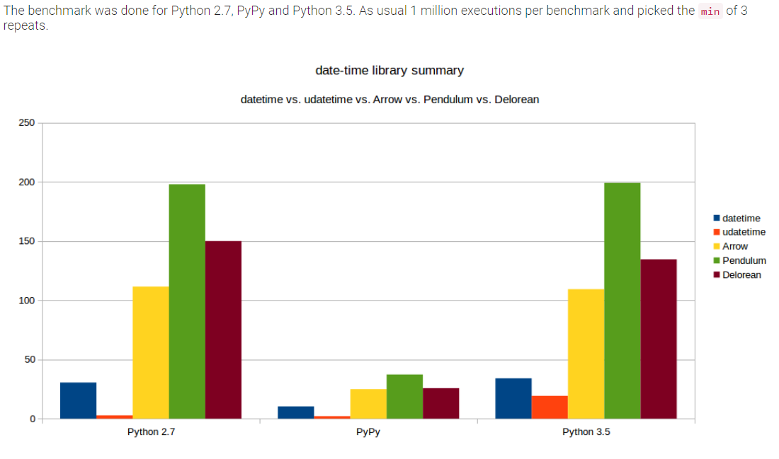
Pendulum vs Other Libraries
Arrow, datetime, Delorean, Pendulum, udatetime
Pendulum is newer than some others
Fixes bugs from Arrow
Provides a richer, more convenient API for datetime, filling the gaps of the standard library.
Notes:
Native datetime instances are enough for basic cases but when you face more complex use-cases they often show limitations and are not so intuitive to work with. Pendulum provides a cleaner and more easy to use API while still relying on the standard library. So it’s still datetime but better. Unlike other datetime libraries for Python, Pendulum is a drop-in replacement for the standard datetimeclass (it inherits from it), so, basically, you can replace all your datetime instances by DateTime instances in you code (exceptions exist for libraries that check the type of the objects by using the type function like sqlite3 or PyMySQL for instance).It also removes the notion of naive datetimes: each Pendulum instance is timezone-aware and by default in UTC for ease of use.Pendulum also improves the standard timedelta class by providing more intuitive methods and properties.

Slide 4
The Goal
Show the difference between using the native and Pendulum
Show other features of Pendulum
https://colab.research.google.com/drive/1SkyRt4oI-Milit4Q5waafdcCwhMq3JWn

